Slide 1
Opencart Ecommerce website
UNDER GUIDANCE OF VAISHALI MAM

Slide 2
INTRODUCTION
Purpose : To perform automation testing on Opencart ecommerce website.
Automation testing uses tools and scripts to validate functionality.
For e-commerce, automation testing ensures :
- Faster execution
- Consistency in Repeated test cases
- Accurated regression testing
- Early Defect Detection

Slide 3
OVERVIEW
Open Cart website provides products which includes laptops, electronics and more.
Key Features Automated :
User login and authentication
Product search
Adding/ removing items from cart
Adding Address
Product categories
Change Password

Slide 4
Modules
Module 1 : Register Page and Login Page
Checked all the functionalities on the Register Page which included:
Entering credentials
Validating login functionality
Verifying error messages for invalid credentials
Ensuring Forgot password links work properly
Module 2 : Search Functionality
Checked all functionalities related to product search which included :
Validating search results
Working of filter
Navigation of product pages from search
Module 3 : Cart Functions
Checked all functionalities related to cart which included :
Adding products to cart
Verifying product details in cart
Removing items from cart

Slide 5
Modules
Module 4: Product Page
Checked all the functionalities on the product page which included:
Viewing product description and details
Item availability
Verifying add to cart functions
Module 5 : Add Address
Checked all functionalities related to adding the address which included :
adding address in the profile
Verifying changes are saved
It should reflect the data
Module 6: My Account Page
Checked all functionalities related to My Account which included :
Updating user details
Updating passwords
Managing wishlist

Slide 6
DEFECTS
A defect occurs when the actual result of a test case does not match the expected result. So created defect report on it.

Slide 7
Defect identifier | Def_opencart_001
Defect summary | Expected Result = display out of stock tag on product. Actual Result = After clicking on the cart then only we can see that items are out of stock
Test Id | TC_011
Test case name | TC_Cart_011
Module name | Cart Module
Reproducible | 1.Open opencart on desktop browser , seatch any product and Click on Add to Cart button. 2. Click on checkout button.
Severity | Medium
Priority | Medium
Raised by | Devendra(Tester name)
Assigned to | Reeva Shah(TL name)
Date of assignment | 01-09-2025
Status | Open
Snap shots
Fixed by | Yoga(Developer name
Date of fixing=
Approvals=manager name | Vaishali Mam(Manager name)

Slide 8
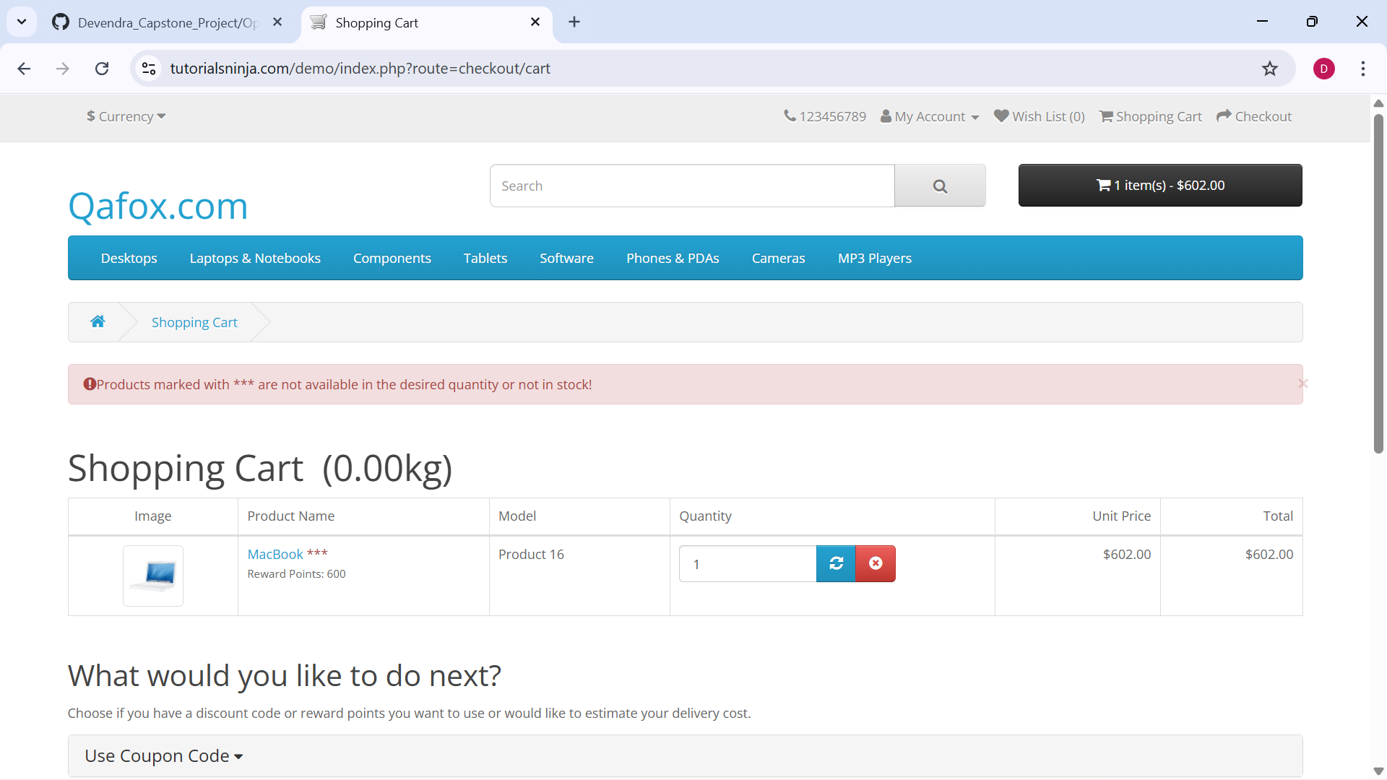
Only Here we can see

Slide 9
FRAMEWORKS USED
Cucumber (BDD) – Behavior Drivenn Development
Selenium WebDriver – Broswer Automation
Maven – Build & Dependancy management
Page Object Model (POM) – Clean Code structure
Extent Reports – For Generating Reports
Jenkins – Continuous Integration / Continuous Delivery

Slide 10
TEST SCENARIOS AUTOMATED
Register Feature
Login Feature
Search Feature
Sort By Feature
Add to Cart Feature
Remove from Cart Feature
Wishlist Feature
Checkout Feature
Add Address Feature
Change Password Feature
Logout Feature

Slide 11
EXECUTION PROCESS
Tests written in Gherkin (Feature files)
Step Definitions using Java + Selenium
Test Runner to execute Feature files
Generating reports: HTMl, JSON, JUNIT
Configured Jenkins pipeline for automatic trigger.
BENEFITS OF BDD
Easy to understand feature files (Human Readable Language)
We can do Data Driven Testing using Feature Files with Scenario Outline
Code reusability

Slide 12
CHALLENGES
Handling Exceptions like Element Not Interactable, Not Clickable
Managing synchronization between Feature files

Slide 13
EXPERIENCE
Gained hands on experience with Cucumber BDD Framework.
Writing scenarios in Gherkin
Got to know how to handle waits and priorities
Understood real time challenges of web testing such as element visibility
Improved debugging skills
Gained experience on Jenkins while creating pipeline which tiggers automatically.

Slide 14
THANK YOU

